Slide 1
DANA 4840
Classification II
Part II Partitional Clustering
Part 6 – Gap statistic

Slide 2
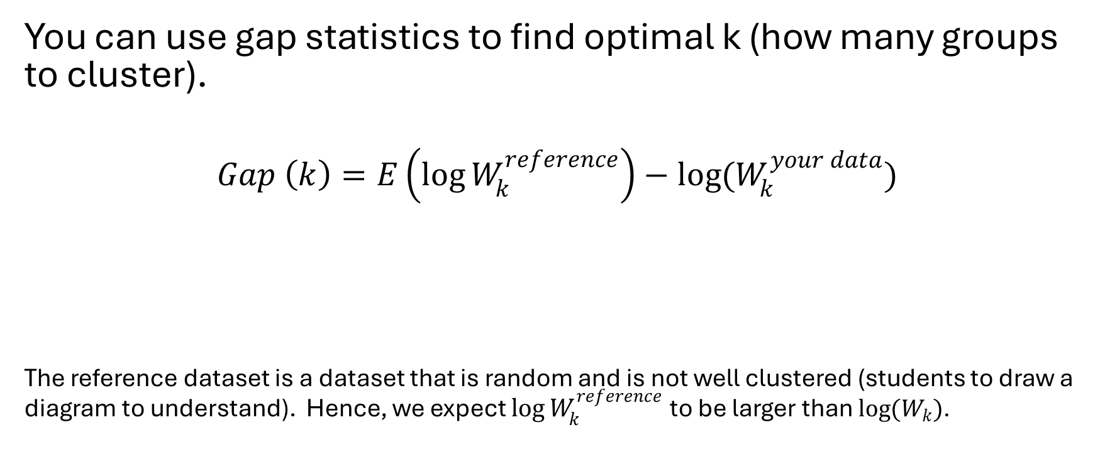
Gap statistic
You can use gap statistics to find optimal k (how many groups to cluster).
$$Gap \left(k\right)=E\left(\log{W_{k}^{reference}}\right)−\log{(W_{k}^{your data})}$$
The reference dataset is a dataset that is random and is not well clustered (students to draw a diagram to understand). Hence, we expect $\log{W_{k}^{reference}}$ to be larger than $\log{(W_{k})}$.
This is the expected value of log of
total WCSS using reference dataset
This is the log of total
WCSS of your dataset

Slide 3
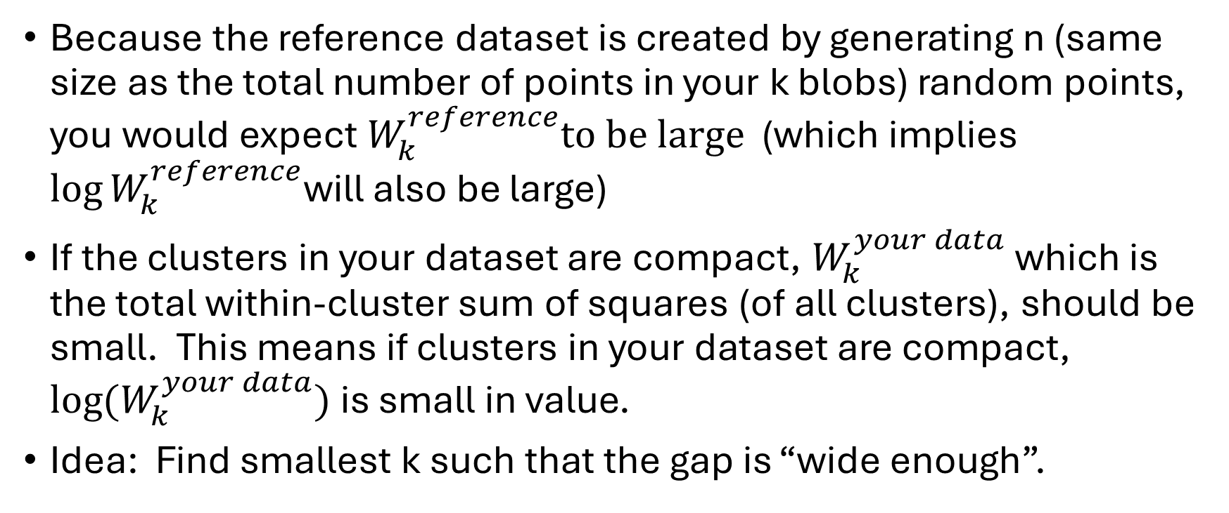
Gap statistic
Because the reference dataset is created by generating n (same size as the total number of points in your k blobs) random points, you would expect${ W}_{k}^{reference}to be large$ (which implies $\log{W_{k}^{reference}}$will also be large)
If the clusters in your dataset are compact, $W_{k}^{your data}$which is the total within-cluster sum of squares (of all clusters), should be small. This means if clusters in your dataset are compact, $\log{(W_{k}^{your data})}$is small in value.
Idea: Find smallest k such that the gap is “wide enough”.

Slide 4
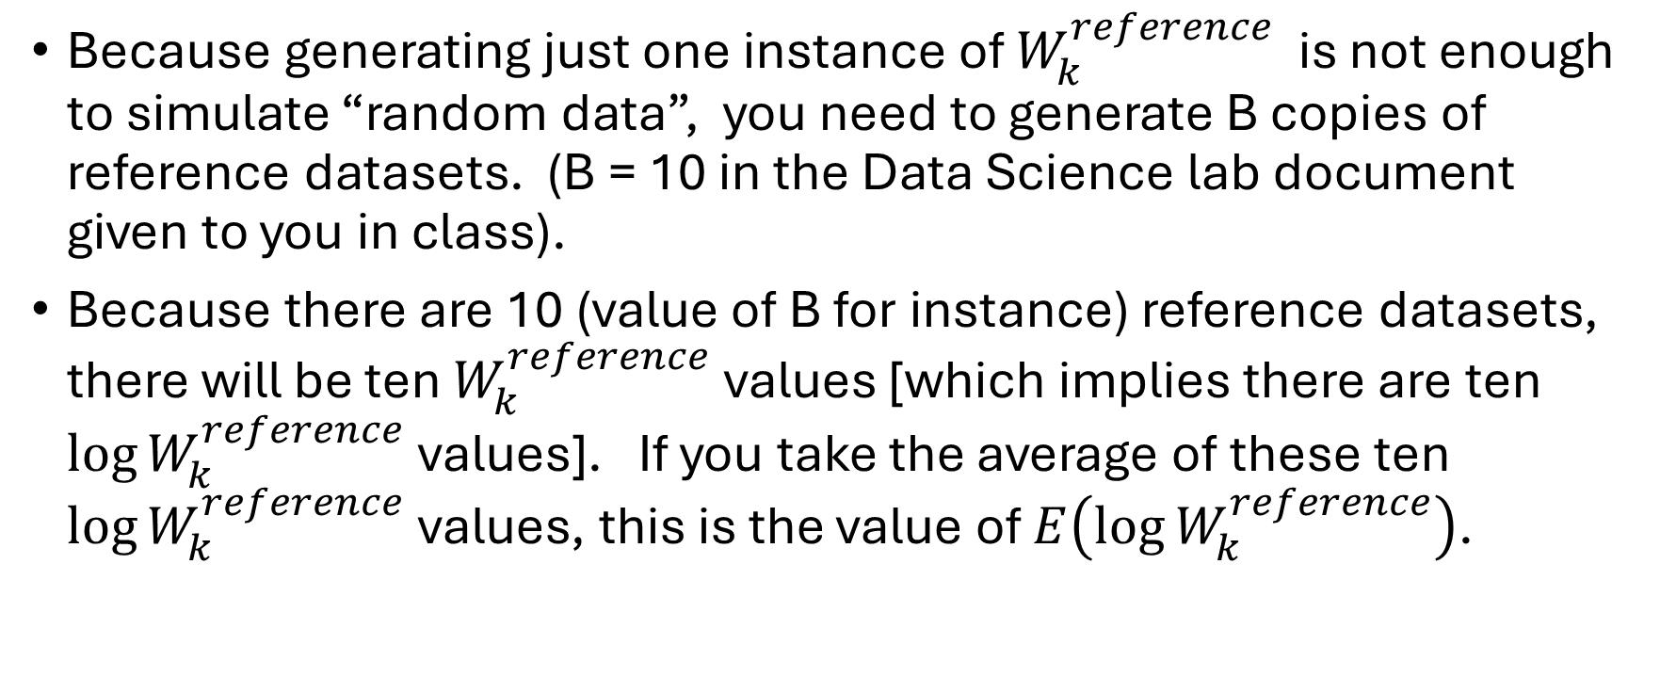
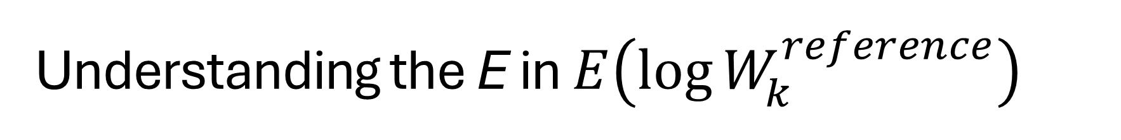
Understanding the E in $E\left(\log{W_{k}^{reference}}\right)$
Because generating just one instance of $W_{k}^{reference}$ is not enough to simulate “random data”, you need to generate B copies of reference datasets. (B = 10 in the Data Science lab document given to you in class).
Because there are 10 (value of B for instance) reference datasets, there will be ten $W_{k}^{reference}$ values [which implies there are ten $\log{W_{k}^{reference}}$ values]. If you take the average of these ten $\log{W_{k}^{reference}}$ values, this is the value of $E\left(\log{W_{k}^{reference}}\right)$.

Slide 5
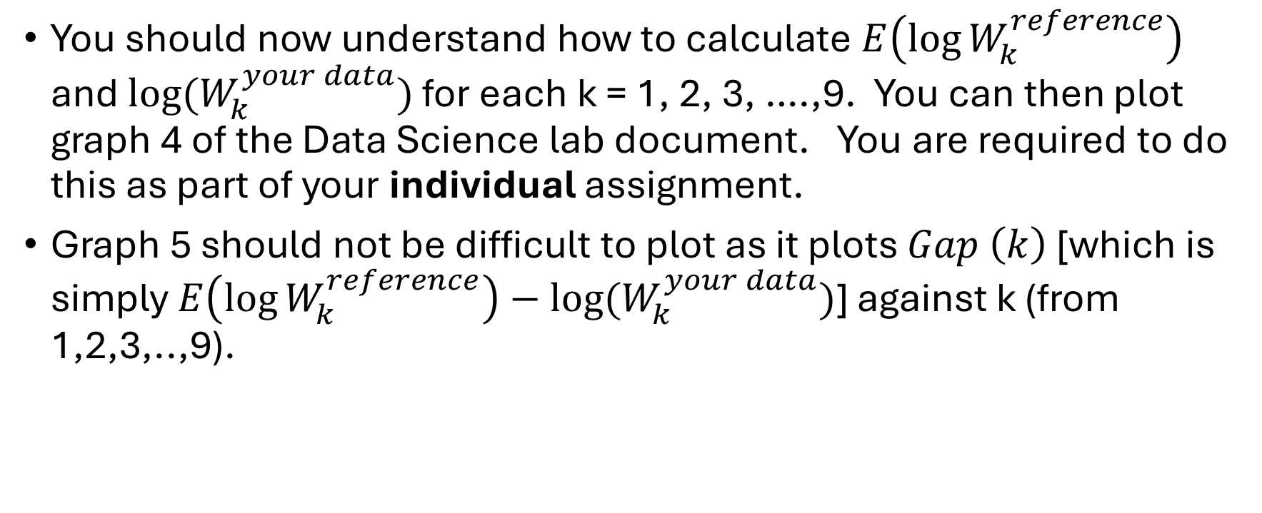
Understanding Graphs 4 and 5 of Data Science lab document:
You should now understand how to calculate $E\left(\log{W_{k}^{reference}}\right)$ and $\log{(W_{k}^{your data})}$ for each k = 1, 2, 3, ….,9. You can then plot graph 4 of the Data Science lab document. You are required to do this as part of your individual assignment.
Graph 5 should not be difficult to plot as it plots $Gap \left(k\right)$ [which is simply $E\left(\log{W_{k}^{reference}}\right)−\log{(W_{k}^{your data})}$] against k (from 1,2,3,..,9).

Slide 6
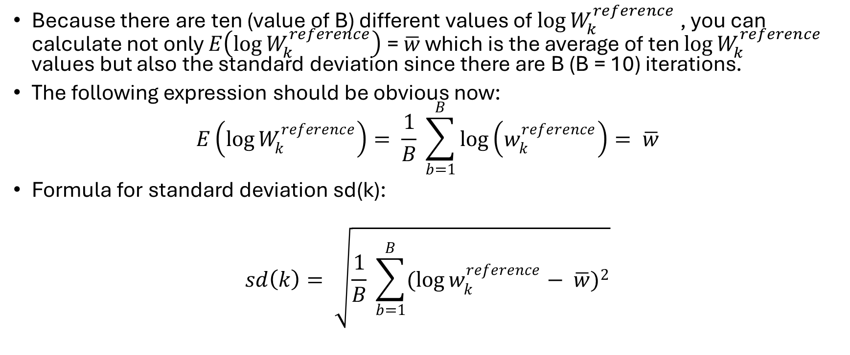

Understanding $sd(k)$
Because there are ten (value of B) different values of $\log{W_{k}^{reference}}$ , you can calculate not only $E\left(\log{W_{k}^{reference}}\right)$ = $\overline{w}$ which is the average of ten $\log{W_{k}^{reference}}$ values but also the standard deviation since there are B (B = 10) iterations.
The following expression should be obvious now:
$$E\left(\log{W_{k}^{reference}}\right)= \frac{1}{B} \sum_{b=1}^{B}{\log\left(w_{k}^{reference}\right)= \overline{w}}$$
Formula for standard deviation sd(k):
$$sd\left(k\right)= \sqrt{\frac{1}{B} \sum_{b=1}^{B}{{(\log{w_{k}^{reference}− \overline{w})}}^{2}}}$$

Slide 7
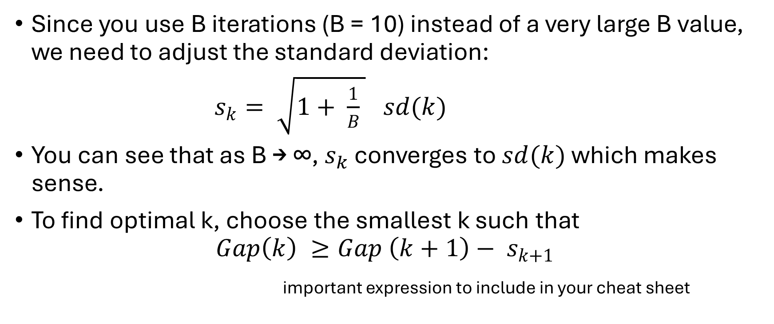
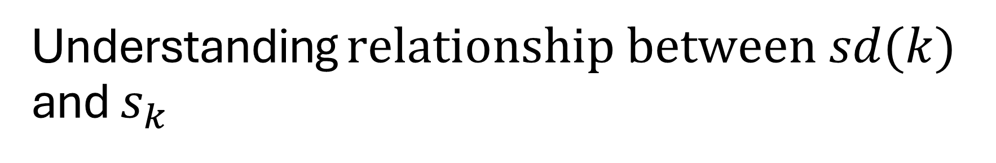
Understanding $relationship between sd(k)$ and $s_{k}$
Since you use B iterations (B = 10) instead of a very large B value, we need to adjust the standard deviation:
$s_{k}= \sqrt{1+ \frac{1}{B} } sd(k)$
You can see that as B → ∞, $s_{k}$ converges to $sd(k)$ which makes sense.
To find optimal k, choose the smallest k such that
$$Gap\left(k\right) ≥Gap \left(k+1\right)− s_{k+1}$$
important expression to include in your cheat sheet

Slide 8
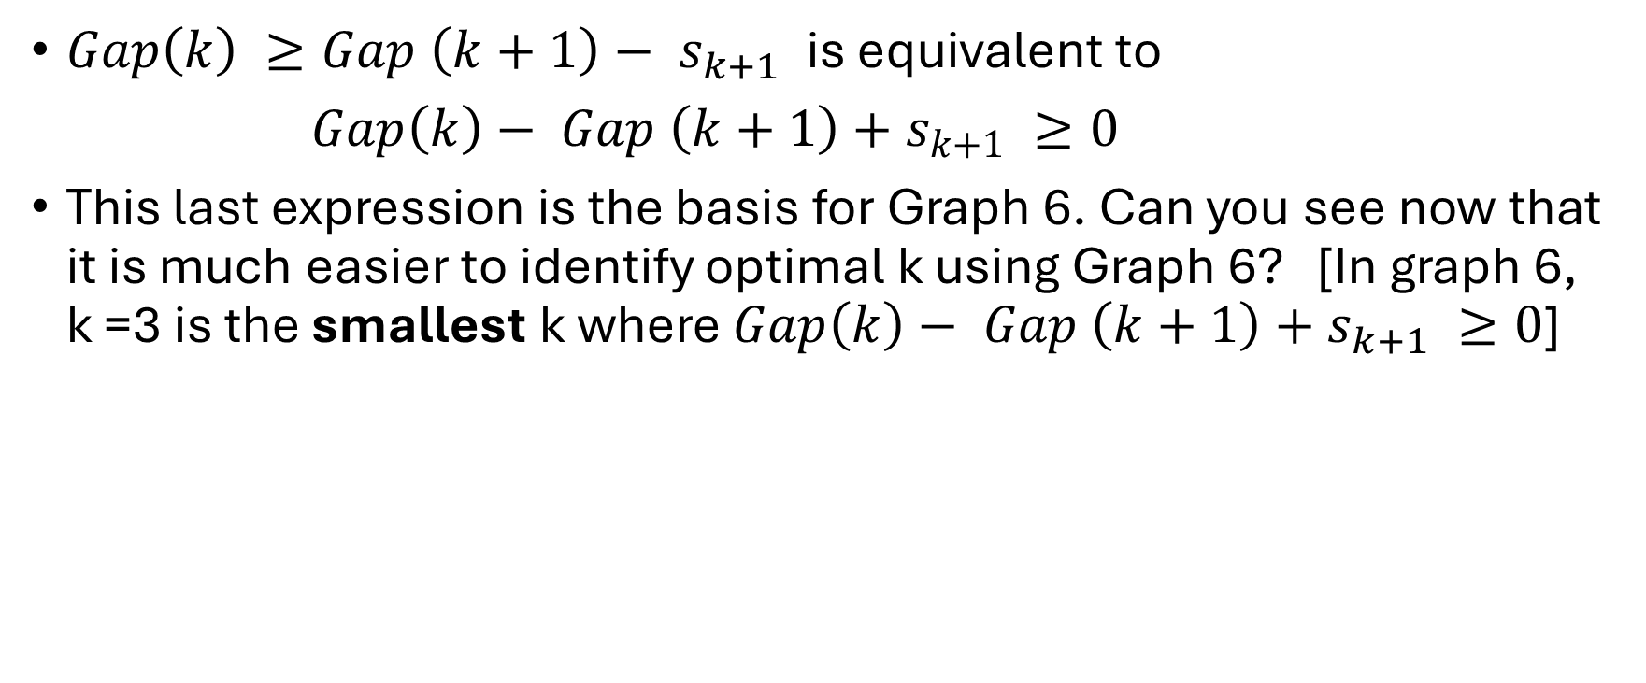
Understanding Graph 6 in Data Science lab document
$Gap\left(k\right) ≥Gap \left(k+1\right)− s_{k+1}$is equivalent to
$Gap\left(k\right)− Gap \left(k+1\right)+s_{k+1} ≥0$
This last expression is the basis for Graph 6. Can you see now that it is much easier to identify optimal k using Graph 6? [In graph 6, k =3 is the smallest k where $Gap\left(k\right)− Gap \left(k+1\right)+s_{k+1} ≥0$]

Slide 9
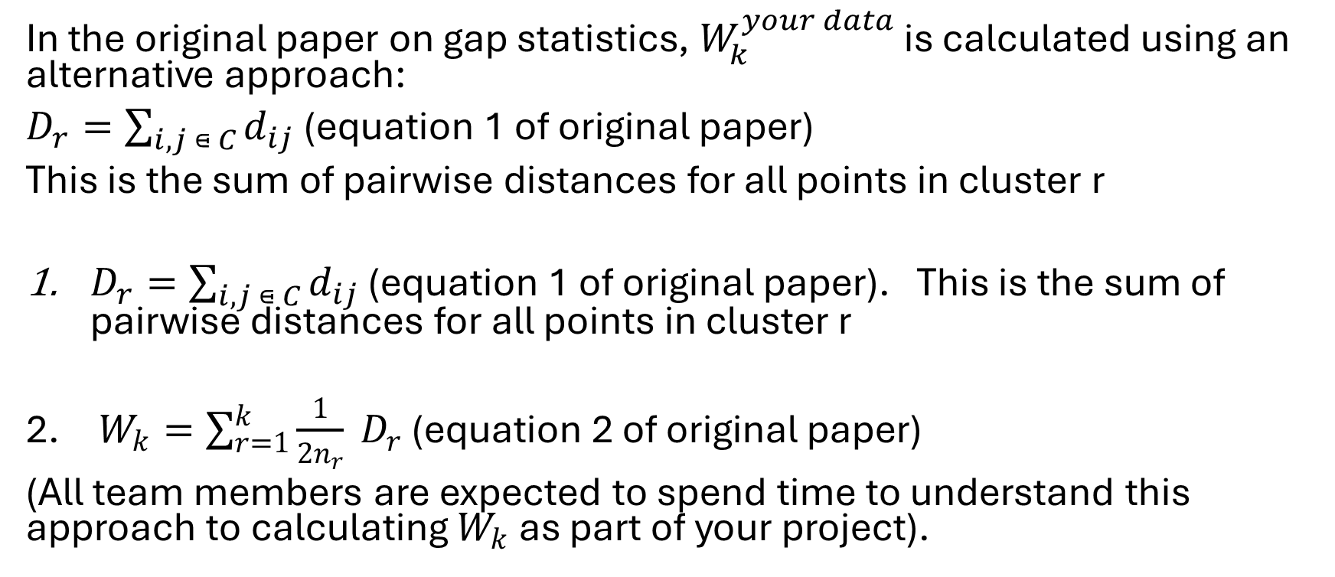
Original paper and part of your project work:
In the original paper on gap statistics, $W_{k}^{your data}$ is calculated using an alternative approach:
$D_{r}=\sum_{i,j ⋴ C}{d_{ij}}$ (equation 1 of original paper)
This is the sum of pairwise distances for all points in cluster r
$D_{r}=\sum_{i,j ⋴ C}{d_{ij}}$ (equation 1 of original paper). This is the sum of pairwise distances for all points in cluster r
$W_{k}=\sum_{r=1}^{k}{\frac{1}{2n_{r}} D_{r}}$ (equation 2 of original paper)
(All team members are expected to spend time to understand this approach to calculating $W_{k}$ as part of your project).

